Slide 1
Weekly report: Rotor Blade Aerodynamics
Week number: 11
Date: 09.12.2025
Supervisor:Prof. Dr. rer.nat. Alois Schaffarczyk
Team Members: Jay Pandya, Harsh Panchal, Kandarp Pathak, Daniyal Sikander
09.12.2025
1
Jay Pandya
Rotor Blade Aerodynamics/ Optimus Syria

Slide 2
List of contents
Blade Geometry
Power Co-efficient Vs Tip speed ratio Graph
Power Vs Wind speed Graph
Radial Position vs Chord vs Twist Angle
Solid works Design
09.12.2025
Jay Pandya
Rotor Blade Aerodynamics / Optimus Syria

Slide 3
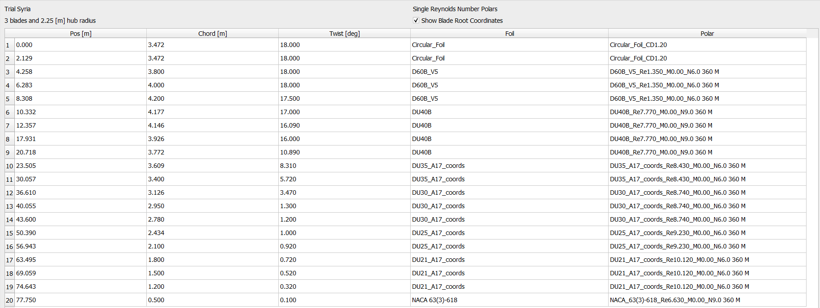
Blade Geometry
Geometry Distribution
Chord starts large at the root (3.47–4.20 m) and decreases steadily to 0.50 m at the tip
Twist angle decreases from 18° at the root to 0.1° at the tip
Smooth geometric taper and twist profile consistent with typical HAWT aerodynamics
Airfoil Strategy
Circular profile at the root (0–2.1 m) for structural robustness
D60B_V5 airfoils from ~4–8 m (high-lift root/mid region)
DU40B / DU35 / DU30 / DU25 / DU21 series used throughout the mid-span for optimized lift-to-drag across Reynolds regimes
NACA 63(3)-618 at the blade tip for low drag and efficiency in clean flow
09.12.2025
Jay Pandya
Rotor Blade Aerodynamics / Optimus Syria

Slide 4
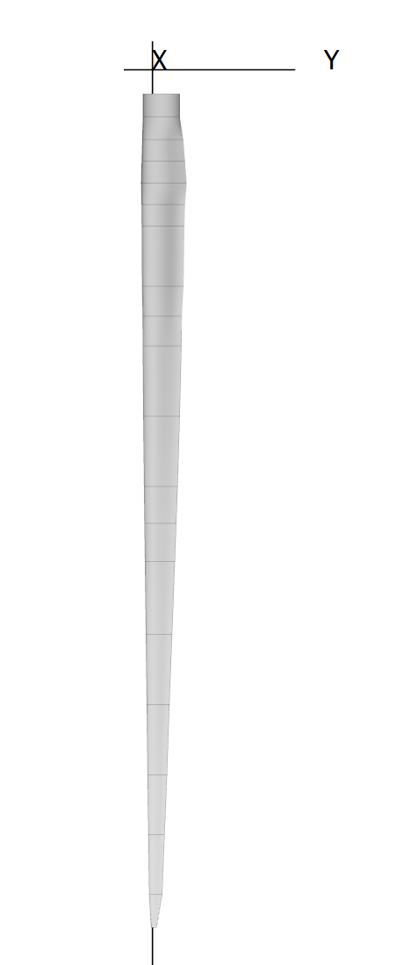
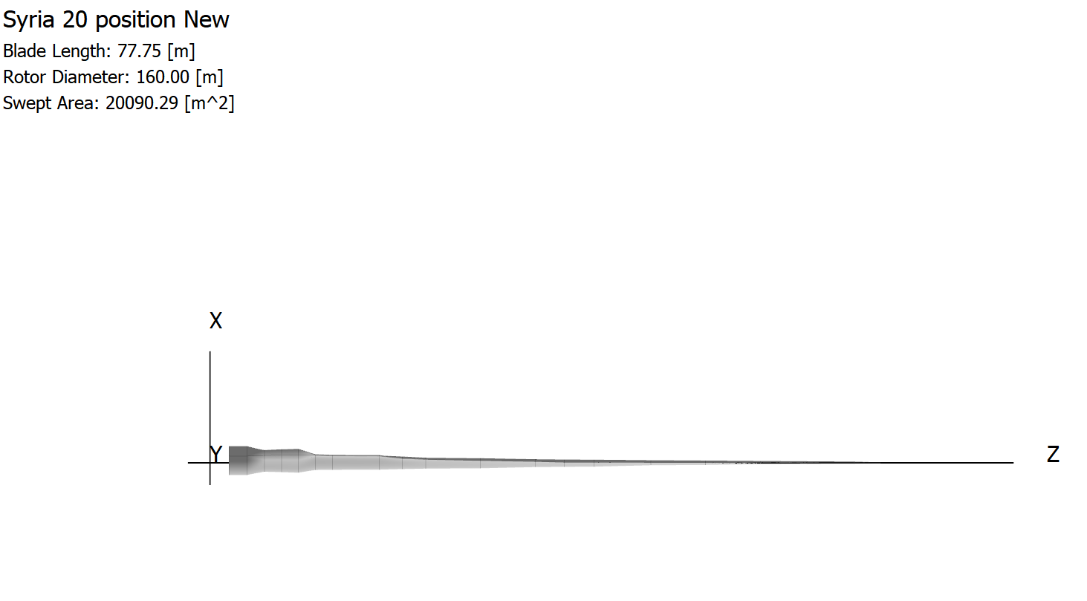
Blade view
Source – Self Generated in Q-Blade
09.12.2025
Jay Pandya
Rotor Blade Aerodynamics / Optimus Syria

Slide 5
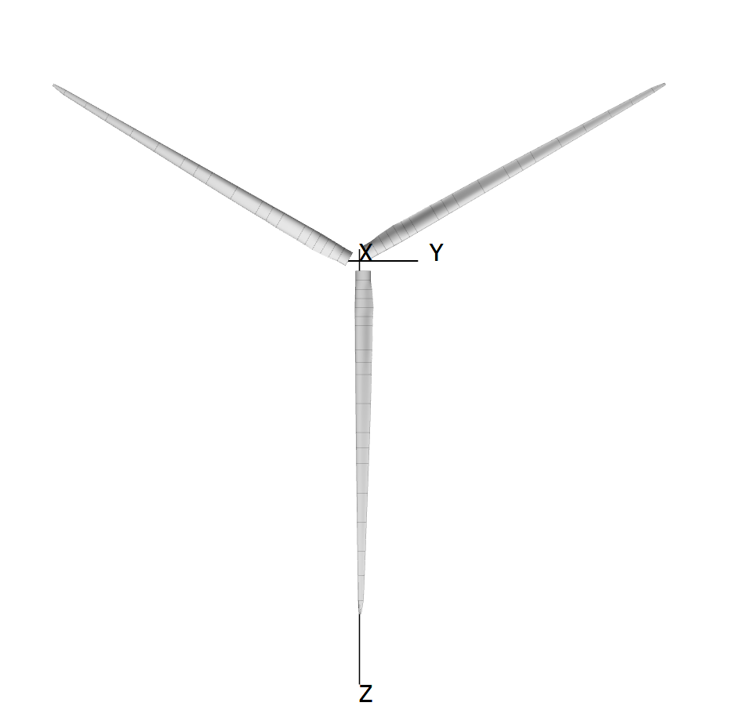
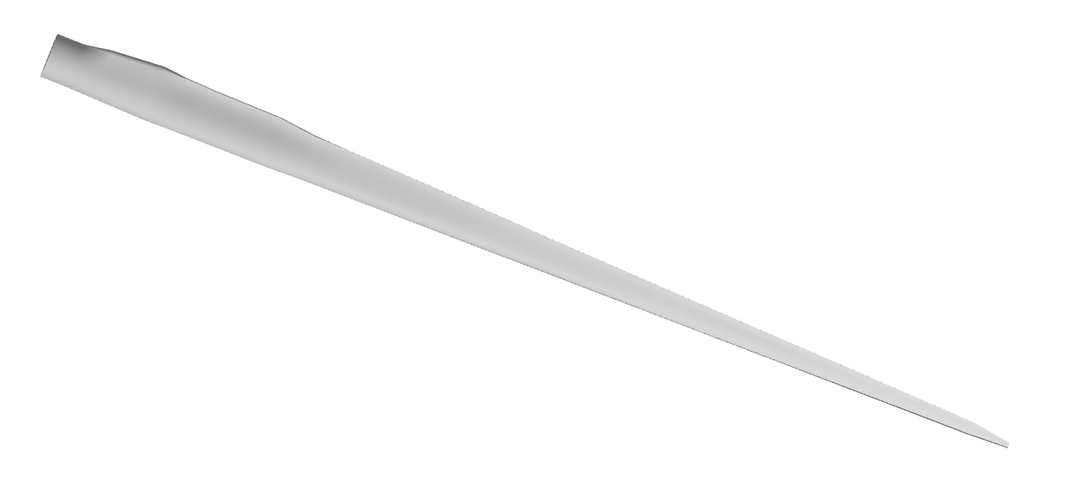
Blade and Rotor view
Source – Self Generated in Q-Blade
09.12.2025
Jay Pandya
Rotor Blade Aerodynamics / Optimus Syria

Slide 6
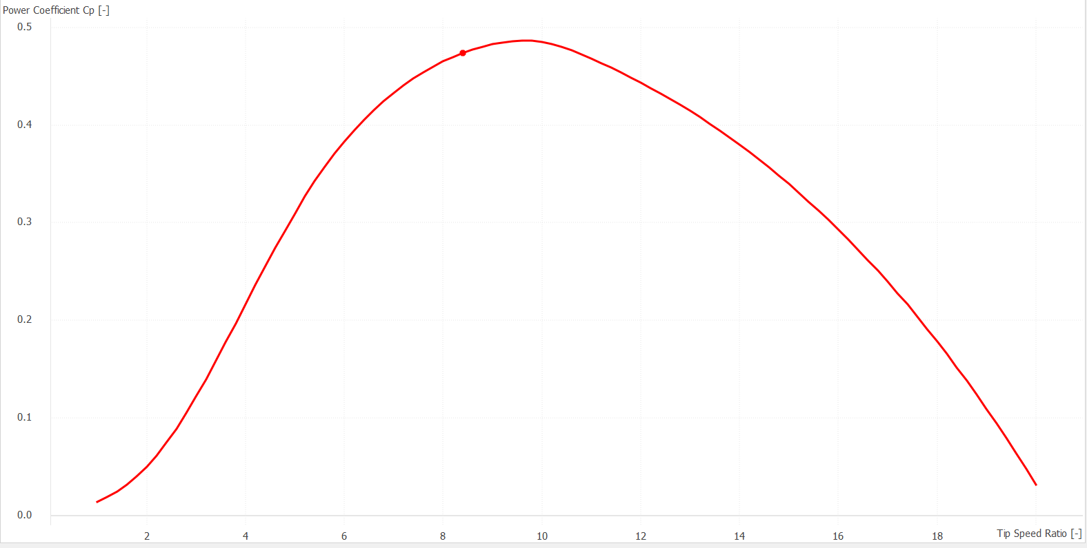
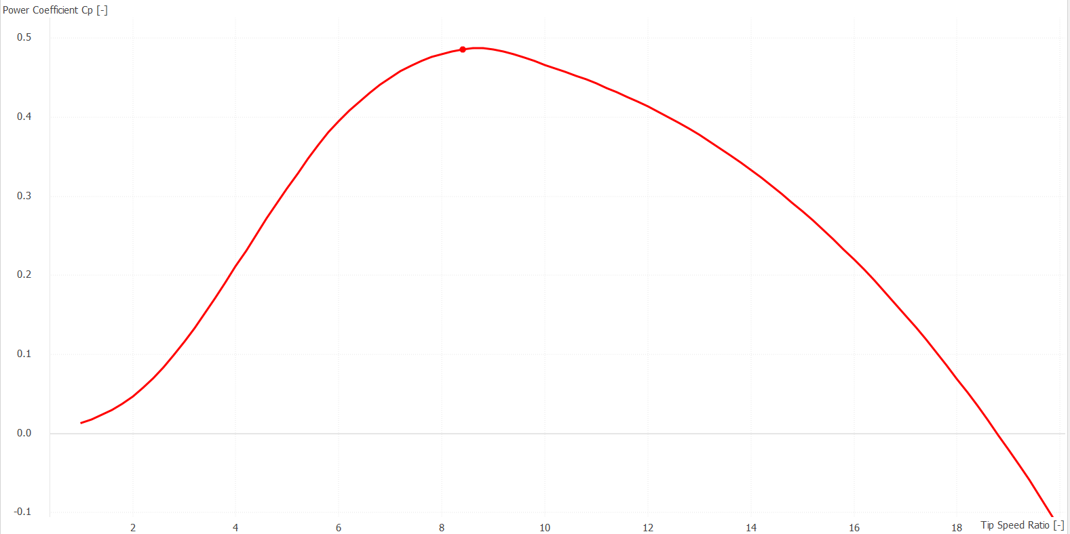
Power Co-efficient Vs Tip speed ratio Graph
1) Cp = 0.476 at TSR = 8.5, Pitch degree = 0
2) Cp = 0.487 at TSR = 8.5, Pitch Degree = -1.5
Source – Self Generated in Q-Blade
09.12.2025
Jay Pandya
Rotor Blade Aerodynamics/ Optimus Syria

Slide 7
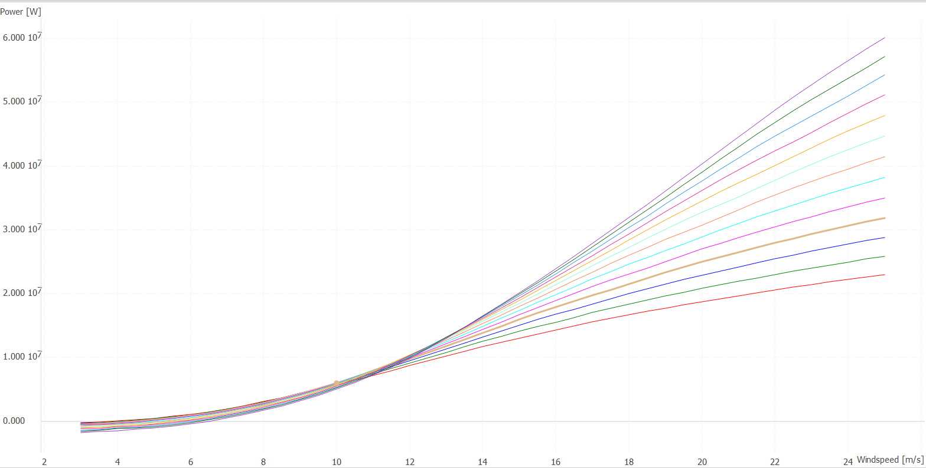
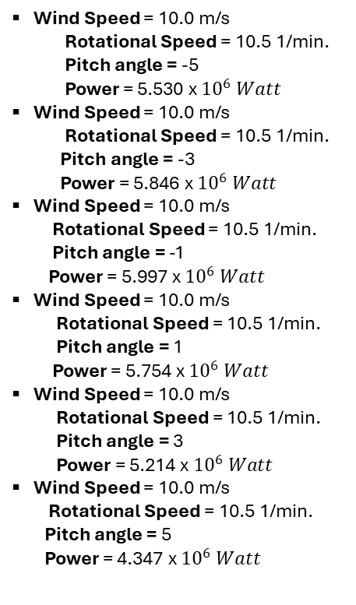
Power Vs Wind speed Graph
Wind Speed = 10.0 m/s
Rotational Speed = 10.5 1/min.
Pitch angle = -5
Power = 5.530 x ${10}^{6} Watt$
Wind Speed = 10.0 m/s
Rotational Speed = 10.5 1/min.
Pitch angle = -3
Power = 5.846 x ${10}^{6} Watt$
Wind Speed = 10.0 m/s
Rotational Speed = 10.5 1/min.
Pitch angle = -1
Power = 5.997 x ${10}^{6} Watt$
Wind Speed = 10.0 m/s
Rotational Speed = 10.5 1/min.
Pitch angle = 1
Power = 5.754 x ${10}^{6} Watt$
Wind Speed = 10.0 m/s
Rotational Speed = 10.5 1/min.
Pitch angle = 3
Power = 5.214 x ${10}^{6} Watt$
Wind Speed = 10.0 m/s
Rotational Speed = 10.5 1/min.
Pitch angle = 5
Power = 4.347 x ${10}^{6} Watt$
Add some text
Source – Self Generated in Q-Blade
09.12.2025
Jay Pandya
Rotor Blade Aerodynamics/ Optimus Syria

Slide 8
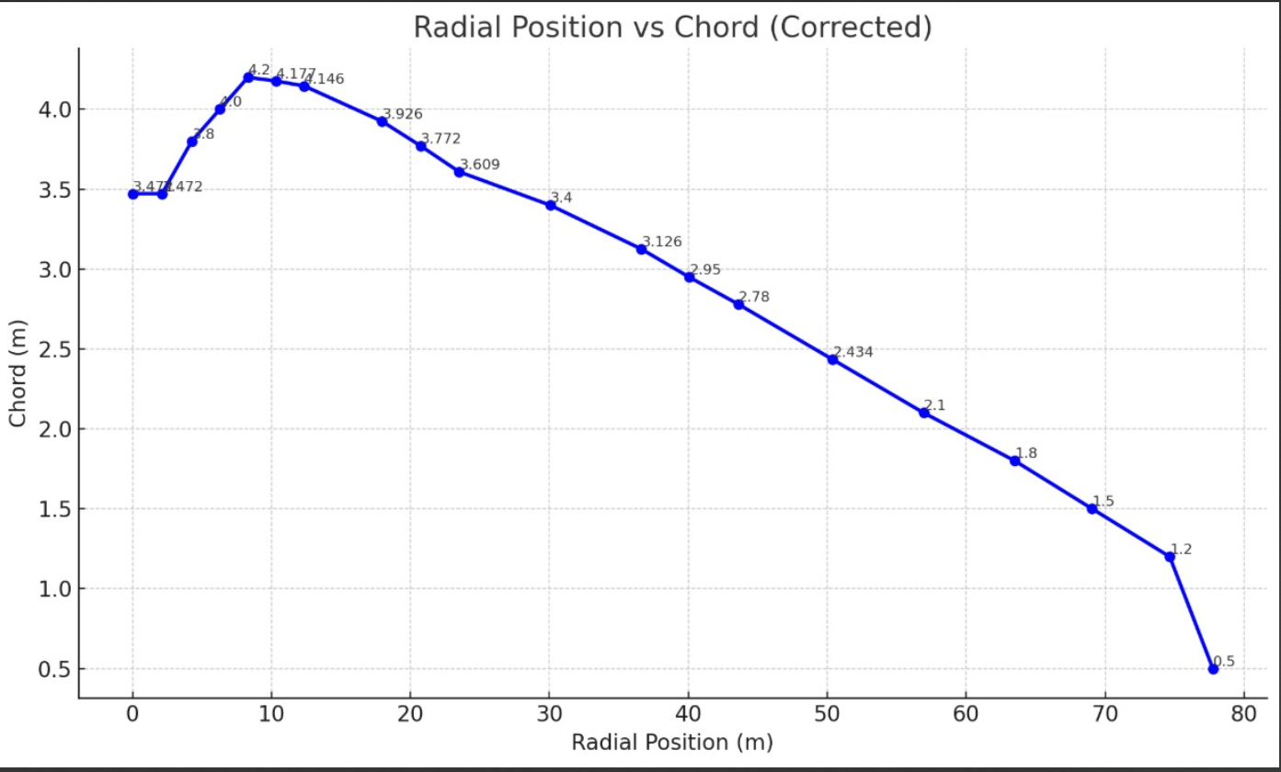
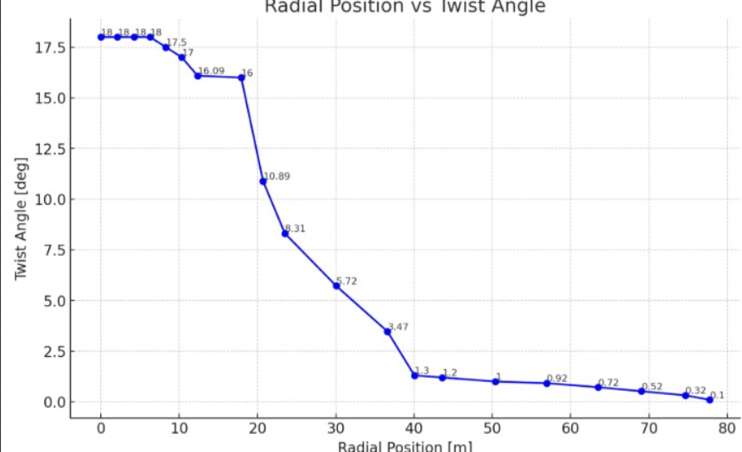
Radial Position vs Chord vs Twist Angle
Figures – Self Generated in Solidworks
09.12.2025
Jay Pandya
Rotor Blade Aerodynamics / Optimus Syria

Slide 9
Solid works design Procedure
1. Airfoil Preparation
Airfoil profiles have been imported using Curve Through XYZ Points.
Each radial station has been assigned its corresponding airfoil.
2. Radial Plane Setup
Offset planes have been created at all Pos [m] locations.
3. Section Adjustment
Airfoils have been scaled to their Chord values.
Required Twist angles have been applied.
4. Section Placement
Airfoils have been positioned on their respective planes with aligned leading edges.
5. Blade Formation
A loft has been created through all sections.
Guide curves have been added for smooth leading and trailing edges.
09.12.2025
Jay Pandya
Rotor Blade Aerodynamics / Optimus Syria

Slide 10
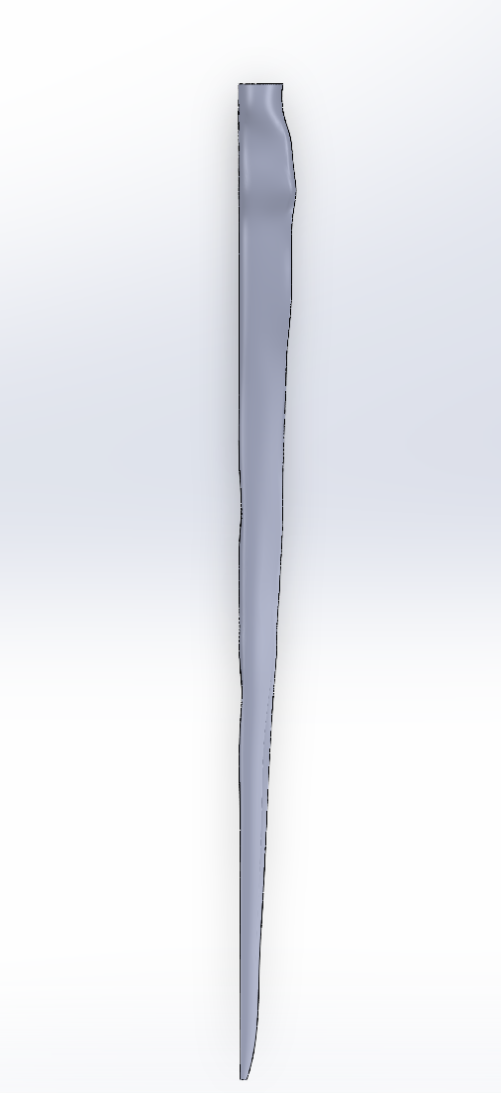
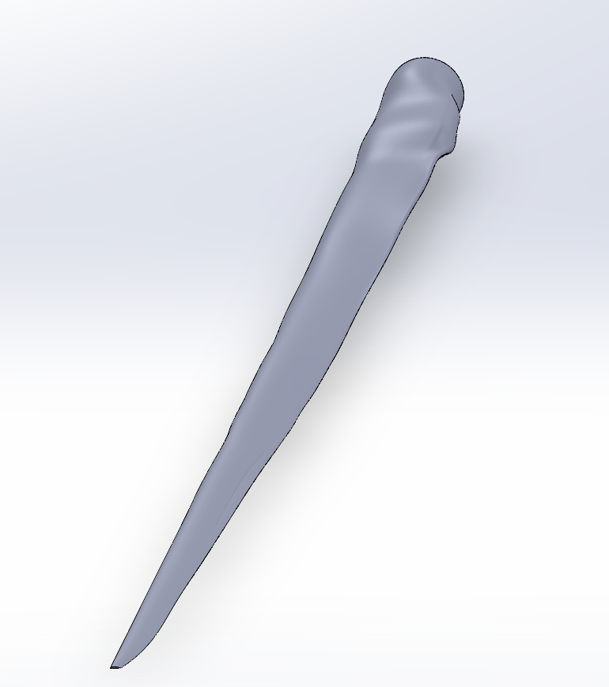
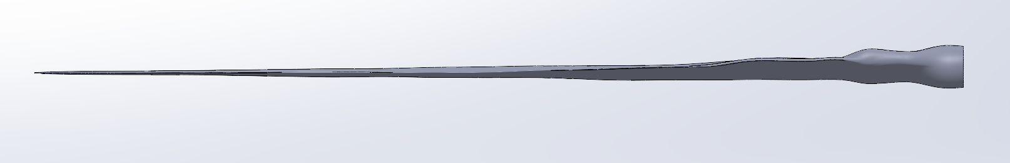
Solid works Design
Figures – Self Generated in Solidworks
09.12.2025
Jay Pandya
Rotor Blade Aerodynamics / Optimus Syria

Slide 11
Bibliography
Self Generated Content in Q-Blade (04.12.2025) (21:30)
Self Generated Design in Solidwork ( 07.12.2025) (18:45)
09.12.2025
Jay Pandya
Rotor Blade Aerodynamics / Optimus Syria

